Slide 1
SafeRoads Navigator
A Platform for Real-Time Road Hazards Management Using Crowdsourcing & Dual Vetting Approach
Arnold Aristotle Tayag (270559700)
Presented 18 July 2025

Slide 2

What is SafeRoads Navigator
A platform for road users to report road hazards & trigger prompt action (🤞🤞🤞) from road authorities
A platform for road authorities to know, with good accuracy, where the road hazards are to quickly resolve them
A platform to give road authorities meaningful data as a basis for present & future road infrastructure planning & development
A platform that aims to reduce road incidents & ultimately save lives (🤲)

Slide 3

Gaps in current Body of Research
The gaps identified in the current literature are as follows:
Reliability of crowdsourced data – how to filter out incorrect or malicious reports without losing the benefits of real–time community inputs. The literature indicates trust mechanisms are needed, but an effective implementation in the road hazard domain is lacking;
Lack of a unified system covering reporting, response, and analysis;
Limited use of crowdsourced verification to improve road safety initiatives as data is not readily analysed or shared for policy use;
Notes:
Justification: This addresses the first gap identified which is about increasing the reliability of crowdsourced data by minimizing false or malicious submissions.
Justification: This addresses the second gap identified by creating a unified solution covering the aspects of crowdsourced reporting, multi–layer verification, operational response, and strategic trend analysis.
Justification: This addresses the third gap enumerated above by providing data analytics and enabling the proposed solution to export datasets on road hazard incidents to be used by city planners, researchers, maintenance teams, and other concerned relevant parties.

Slide 4
Research Questions
The project was guided by the following research questions:
How can real–time trust and reputation mechanisms be designed to automatically validate and filter crowdsourced road–hazard reports without significantly delaying the reporting process?
What architectural and workflow models enable the seamless integration of an end–to–end road hazards management within a single platform?
In what ways can built–in data analytics and open data interfaces be embedded into crowdsourced hazard reporting systems to facilitate immediate policy–relevant insights and stakeholder collaboration?
Notes:
Justification: This addresses the first gap identified which is about increasing the reliability of crowdsourced data by minimizing false or malicious submissions.
Justification: This addresses the second gap identified by creating a unified solution covering the aspects of crowdsourced reporting, multi–layer verification, operational response, and strategic trend analysis.
Justification: This addresses the third gap identified by providing data analytics and enabling the proposed solution to export datasets on road hazard incidents to be used by city planners, researchers, maintenance teams, and other concerned relevant parties.

Slide 5
Definition of Terms
Road Hazard refers to any physical, environmental, or situational condition on or near a roadway that poses a risk to the safety of drivers, passengers, pedestrians, or vehicles.
Road User refers to drivers, motorists, pedestrians, passengers
Road Authorities are entities such as the NZTA, Auckland Council, and their intermediaries
Vetting – to formally evaluate, check, or approve a hazard report to ensure suitability or correctness
Peer-vetting (applies to road users thru upvoting or flagging)
Authority-vetting (applies to road authorities thru moderation)
Upvoting – to express approval or agreement with a hazard report
Flagging - to mark a report hazard for attention or treatment as non-existent
Geocoding - the process of converting textual location descriptions, like street addresses, into geographic coordinates (latitude and longitude)
Notes:
B4 we go deeper in our discussion, allow me to present some Terms and their meanings in the context of my research study

Slide 6

Road Hazard Management Lifecycle
A road hazard, when reported: (1) will have a description & an image uploaded, (2) will be assigned a type (hazard_type_id)
Road Hazard Classes & Types:
Road Surface Defects, e.g. potholes, loose gravel/debris, etc.
Environmental and Weather-Related Hazards, e.g. flooding, fog, etc.
Physical Obstructions and Debris, e.g. fallen trees, rock falls, etc.
Infrastructure and Signage Issues, e.g. malfunctioning traffic signals, etc.
Human and Vehicle-Related Hazards, e.g. aggressive driving, road rage, etc.
Temporary or Event-Driven Hazards, e.g. temporary detours, road closures, etc.
Notes:
Road Surface Defects (e.g. Potholes, Loose Gravel or Debris, Faded Road Markings, etc.)
Environmental and Weather-Related Hazards (e.g. Icy of frosty roads, Heavy rain & flooding, Fog & reduced visibility, etc.)
Physical Obstructions and Debris (e.g. Fallen trees or branches, Rock falls, Construction debris, etc.)
Infrastructure and Signage Issues (e.g. Malfunctioning traffic signals, Missing or faided road signange, etc.)
Human and Vehicle-Related Hazards (Aggressive/erratic driving, Road rage incidents, etc.)
Temporary or Event-Driven Hazards (Construction zones, road closures, temporary detours, etc.)

Slide 7

Road Hazard Management Lifecycle
(3) is also assigned a severity (user_severity_id), and is color–coded when shown in Google Maps
Road Hazard Severity:
Negligible - 🟢
Minor - 🔵
Moderate - 🟡
High - 🟠
Critical - 🔴
(4) geolocation (Lat & Lang) is auto–captured or geocoded (if geolocation support is not available)

Slide 8
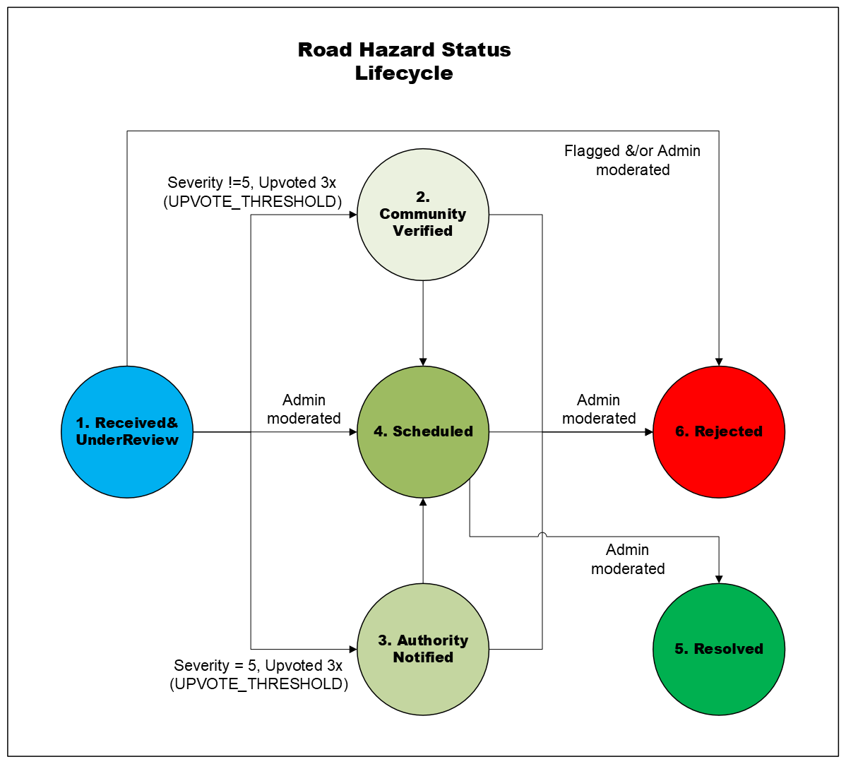
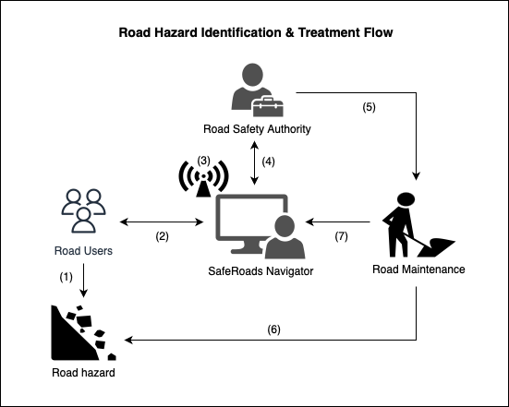
Road Hazard Management Lifecycle
(5) will have an initial status of Received&UnderReview (hazard_status_id=1)
Notes:
Actors in the PFD: (1) road users, (2) road safety authorities, (3) road maintenance officers, (4) application
The hazard status lifecycle (left) fits very neatly into the road hazard management workflow (right)
Note: the communication between road safety authorities & road maintenance officers is not yet handled by the system and is mentioned as a limitation

Slide 9

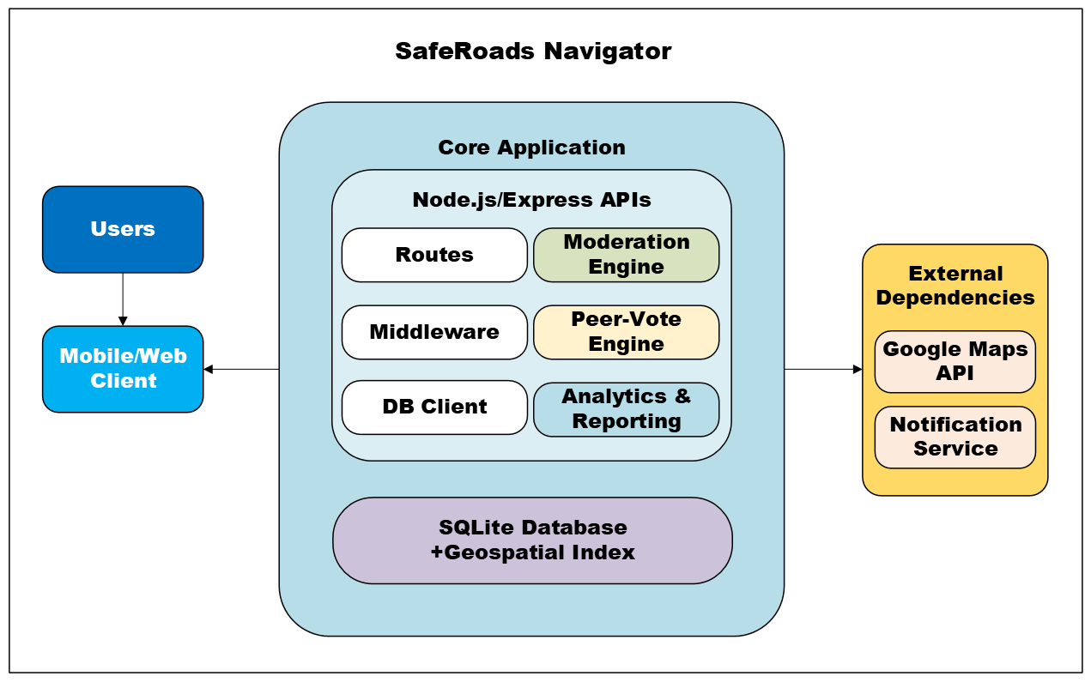
Architecture Diagram
Notes:
The workflow presented above is managed by my application having the ffg. architecture diagram:
Front-end: HTML5, CSS3, Bootstrap5, Javascript, Websockets (real-time communication), 3rd-party javascript libraries (Chart.js, Leaflet.js), Google Maps API & Nominatim
Backend: Pure javascript implementation using Node.js / Express.js, NPM as package manager, SQLite, 3rd party javascript libraries (bcrypt, multer, dotenv, nodemailer)

Slide 10
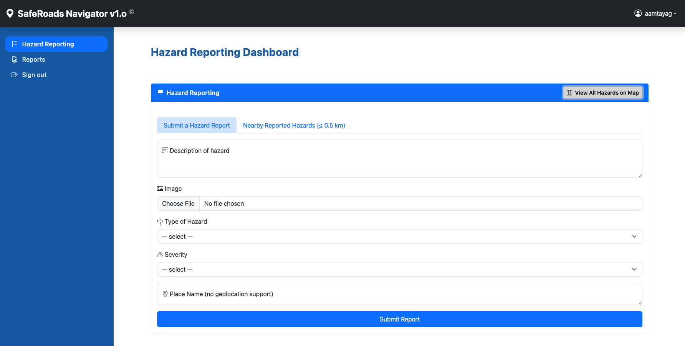
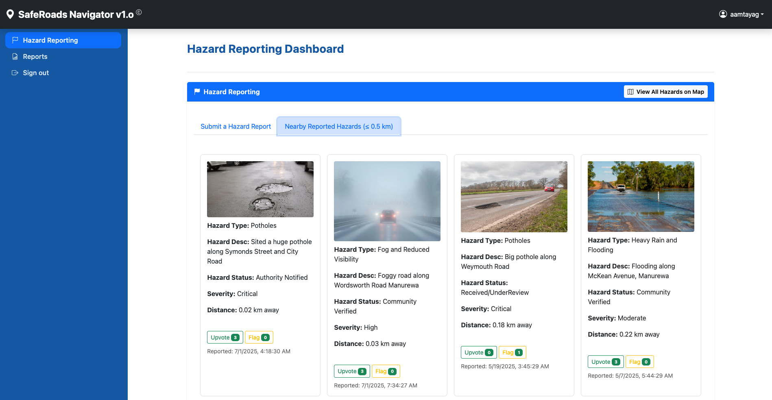
Hazard Reporting Module

Slide 11
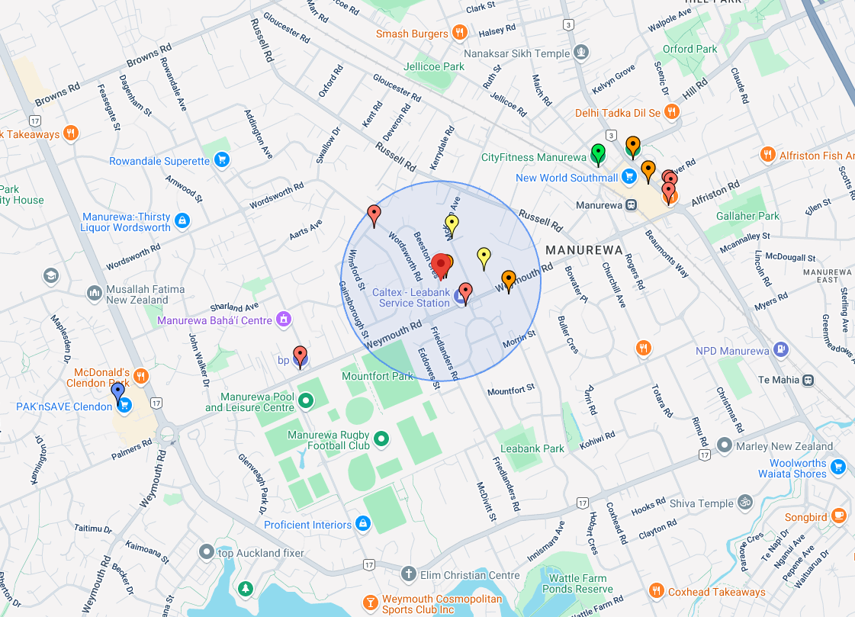
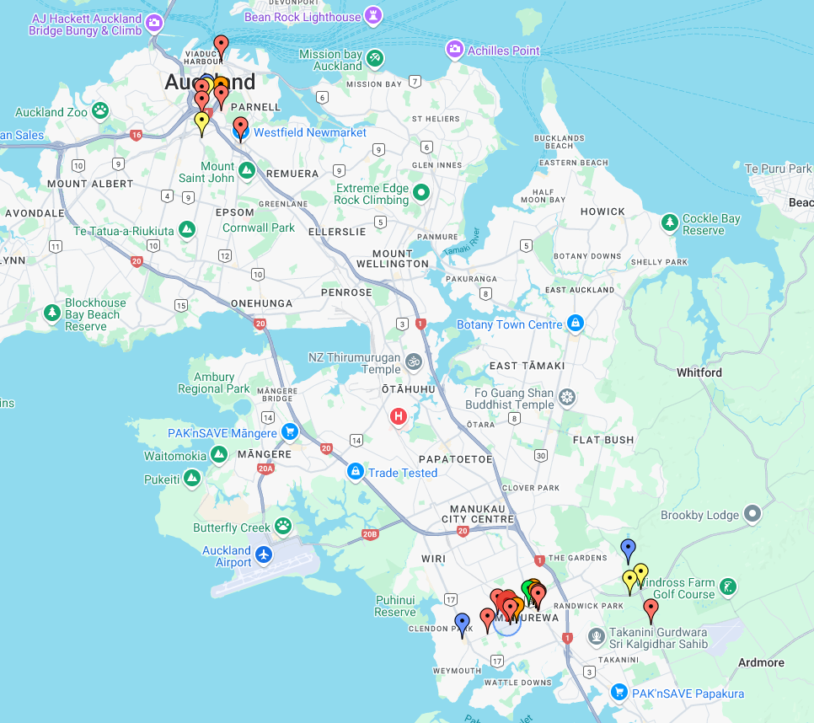
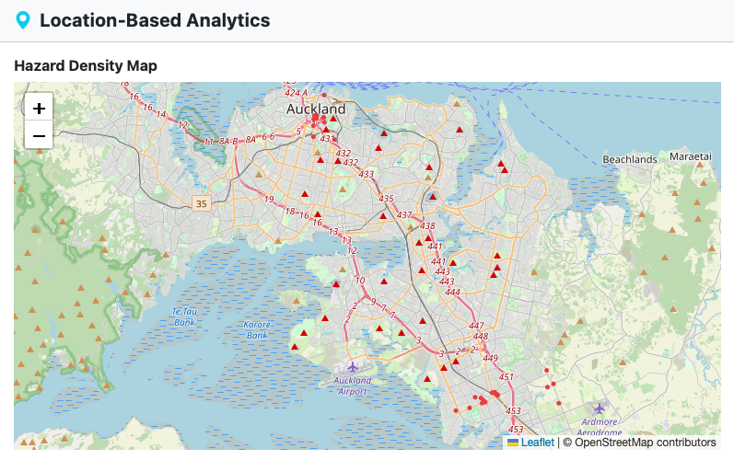
Report Hazard Mapping

Slide 12
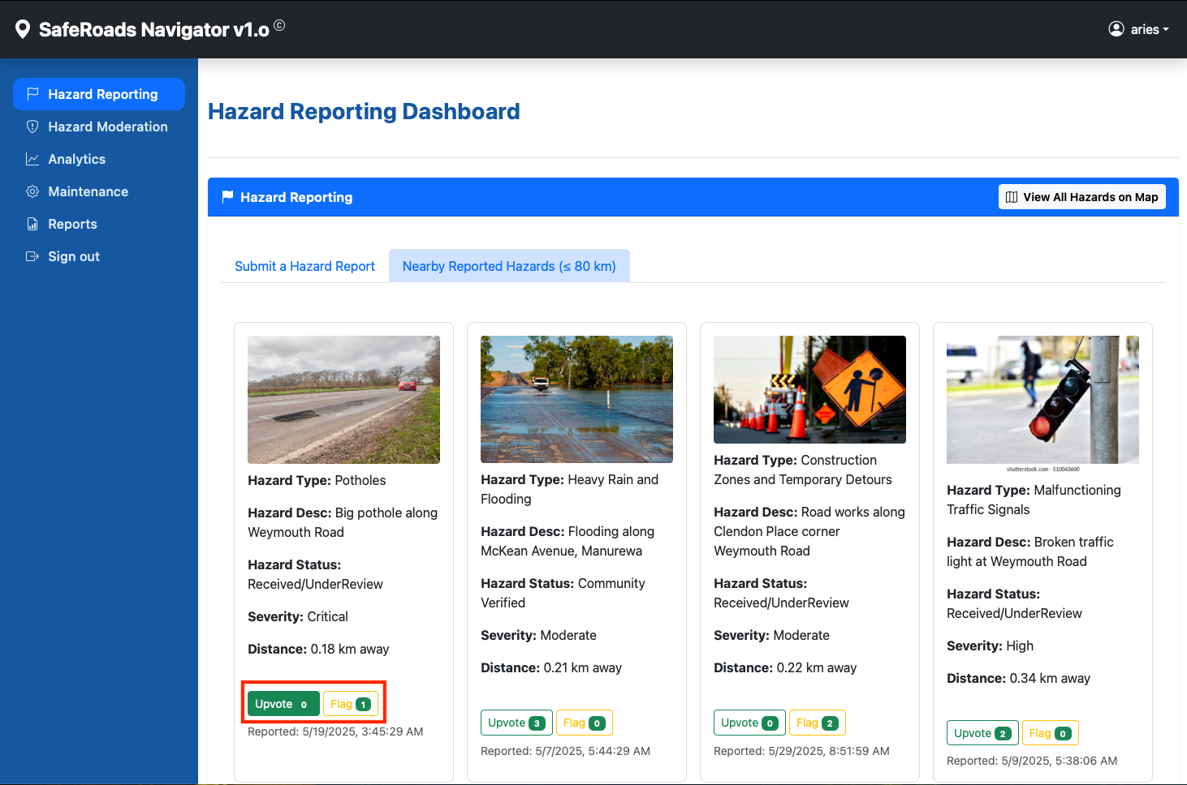
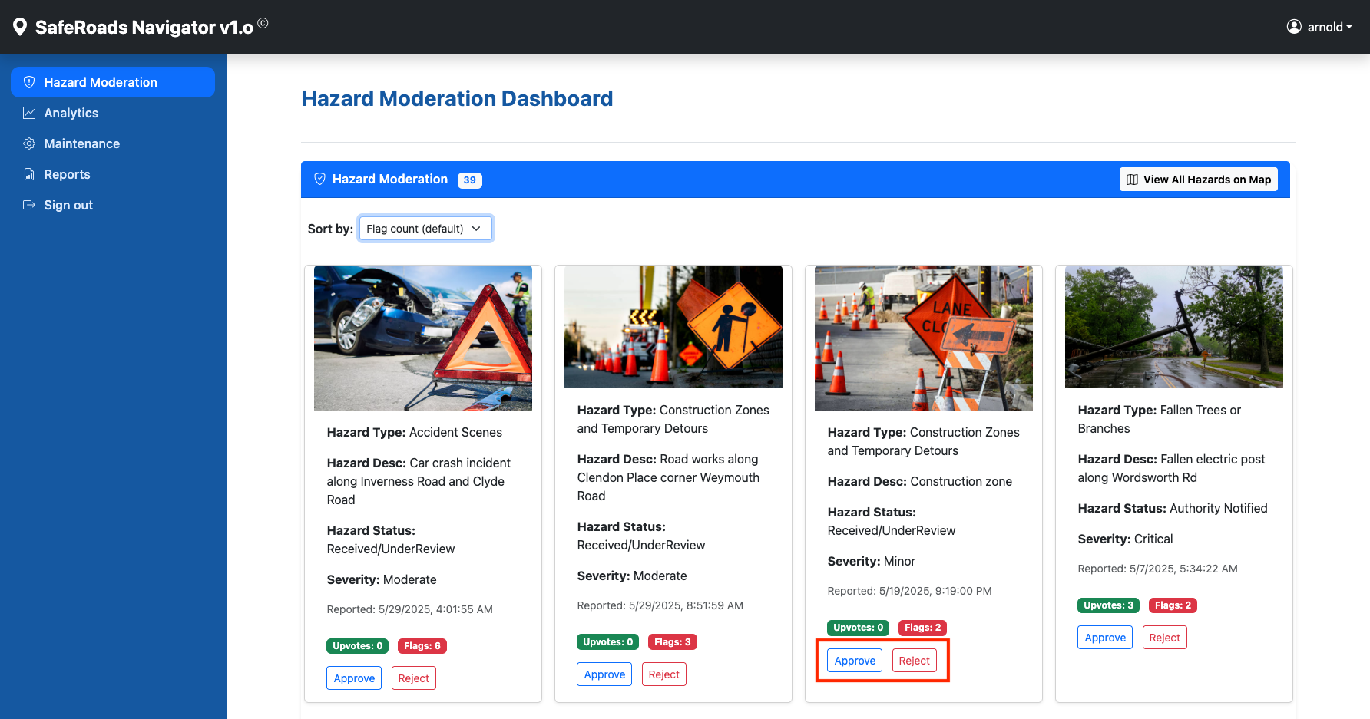
Dual–Vetting Approach

Slide 13
Limitations
While SafeRoads Navigator has achieved the objectives and functionalities set forth in this study, several limitations were identified in the course of final implementation:
Geocoding Accuracy – there may be times when geolocation fails to capture the actual location of the reported hazard. Though this may be the case, the coordinates captured have good accuracy;
No mobile app integration – this is identified as a future work for this project;
Communication between road safety authorities and road maintenance officers is not currently handled in the system;
Security considerations – while encryption and hashing are applied to sensitive data (PIIs), further security hardening such as HTTPS enforcement should be implemented.
Notes:
Scope will not be discussed. It will be apparent when I do the system demo.

Slide 14
System Demo?

Slide 15




Thank You!
Do you have any questions?
270559700@yoobeestudent.ac.nz

